Slide 1
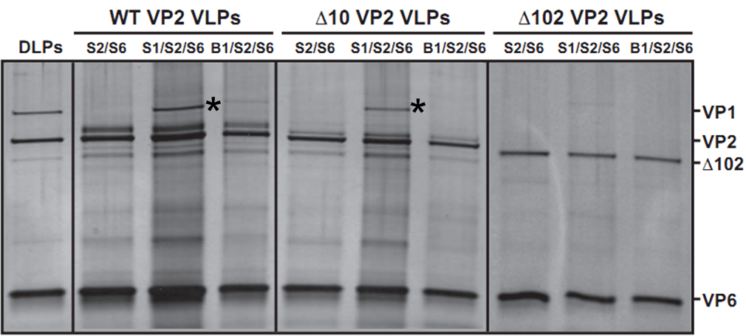
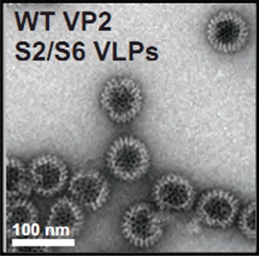
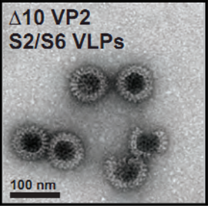
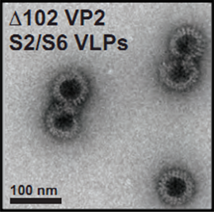
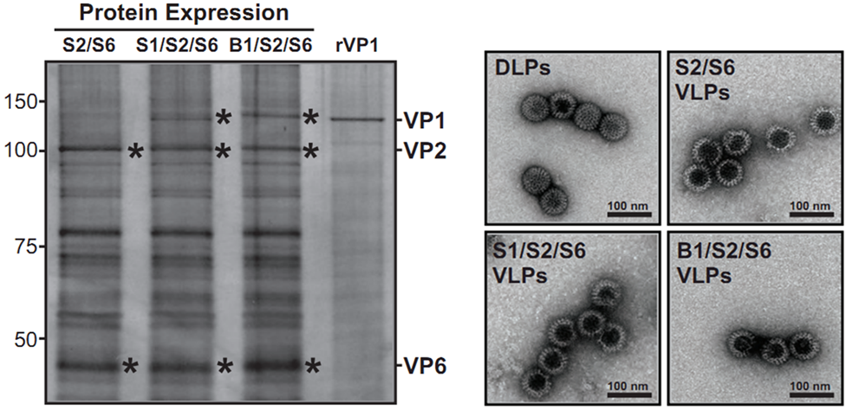
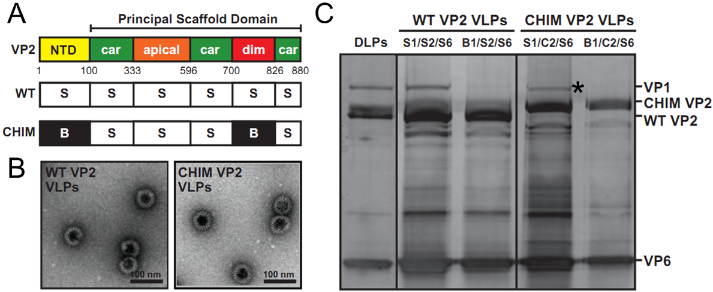
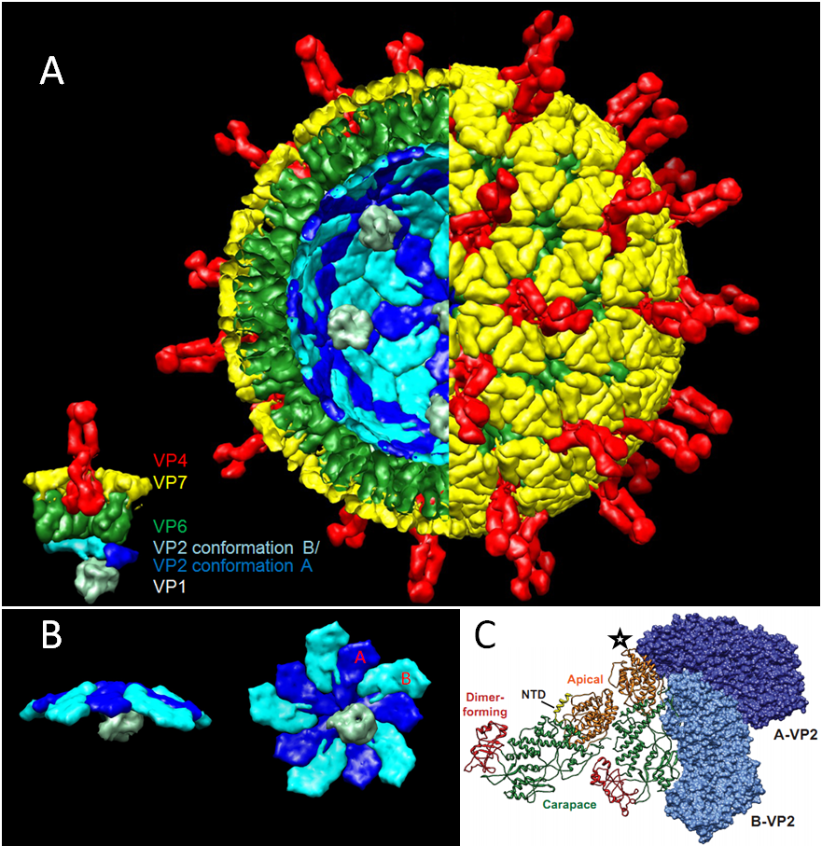
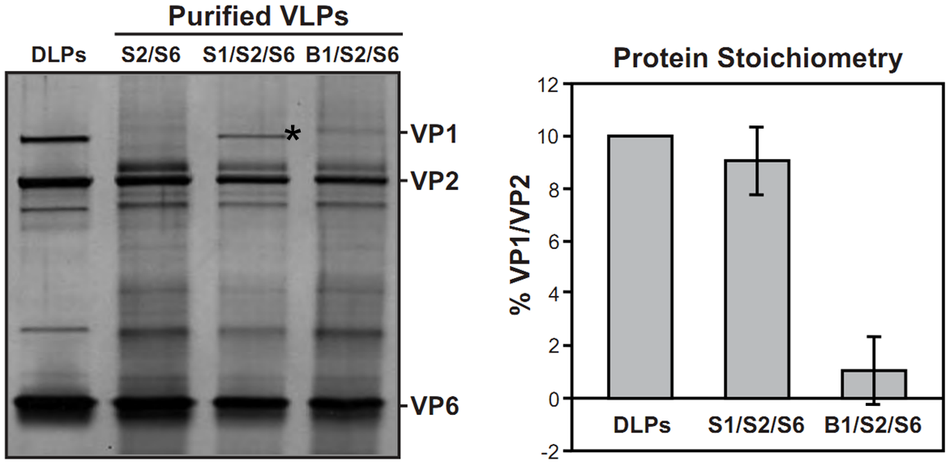


Rotavirus VP1-VP2 Interactions During Core Assembly and Replication
Donald C. Vile¹, Crystal E. Boudreaux¹, Brian L. Gilmore¹, Justin R. Tanner¹, Deborah F. Kelly^{1,2}, and Sarah M. McDonald^{1,3}
¹Virginia Tech Carilion School of Medicine and Research Institute; ²Department of Biological Sciences, Virginia Tech;
³Department of Biomedical Sciences and Pathobiology, Virginia-Maryland Regional College of Veterinary Medicine
Introduction
Methods
Encapsidation into Truncation Mutants
Rotavirus (RV) is the leading cause of severe gastroenteritis in children worldwide, killing 500,000 children per year.
Current vaccines are less effective where mortality is greatest, and recent evidence demonstrates that the risk of intussusception with second-generation, live vaccines remains.
Alternatives to live vaccination include vaccination with virus-like particles (VLPs) and direct-acting antivirals.
RV’s triple-layered capsid encases an eleven-segmented, double-stranded, RNA genome and 11-12 copies of the viral polymerase, VP1. VP1 performs both transcription and replication while tethered to the inner surface of the core shell protein, VP2. During core assembly, VP2 directly engages VP1, accomplishing both encapsidation of VP1 and activation, initiating minus-strand RNA synthesis on bound +RNA templates.
Our primary aim was to further elucidate the interaction between the RV inner-core shell protein, VP2, and the RNA-dependent RNA polymerase, VP1, a common target for disease modifying, small molecule inhibition among RNA viruses, during encapsidation into recombinant VLPs.
We asked, what are the regions of VP2 that mediate encapsidation of VP1?
We proposed that the encapsidation of VP1 by VP2, like activation, involves a strain specific interaction and is mediated by the VP2 apical and carapace subdomains rather than the NTD.
We used the approach developed by Crawford and Zeng that relies on the capacity of VP2 to form soluble, stable, recombinant VLPs when co-expressed from a baculovirus vector along with VP6 in Spodoptera frugiperda (Sf9) cells.
Simian RV SA11 VP1 and Bristol VP1, from a strain that infects humans, were used to compare strain specificity of encapsidation into VLPs consisting of SA11 VP2 and VP6 (S2/S6).
The regions of SA11 VP2 responsible for encapsidation of SA11 VP1 were further narrowed using truncation and chimeric mutant VP2 proteins.
Infect Sf9 Cells
Harvest/Clarify
Sucrose Pellet
CsCl Gradient
Dialysis
SDS_PAGE
Negative Stain EM
Both Δ10 VP2 and Δ102 VP2 formed VLPs indistinguishable from WT 2/6 VLPs when co-expressed with SA11 VP6 by negative stain EM (inset). Truncations did not prevent VLP formation.
SDS-PAGE and silver staining suggest new information that is surprising in the context of previous experiments by McDonald and Patton in which Δ10 VP2 demonstrated a severely diminished capacity to activate SA11 VP1: Δ10 VP2 VLPs appear to encapsidate SA11 VP1 with a ratio consistent with that of native DLPs (*). NTD residues 1-10 are not essential for efficient polymerase encapsidation into VLPs.
Protein Expression and Morphology
A
B
Encapsidation by Chimeric VP2
Rotavirus Structure/VLP
(A) Sf9 cells infected with recombinant baculoviruses expressing SA11 VP2 and SA11 VP6 in the absence (S2/S6) or presence of SA11 VP1 (S1/S2/S6) or Bristol VP1 (B1/S2/S6) were lysed at 3 days post infection, and proteins were analyzed by SDS-PAGE and silver staining. Molecular weight markers are shown in kilodaltons, and purified recombinant SA11 VP1 (rVP1) was run as an additional standard.
Both SA11 and Bristol VP1 are equivalently expressed.
(B) Negative stain (1 % Uranyl Acetate for 15 seconds) of native SA11 DLPs and VLPs purified from infected cell culture medium 5 days post infection. VLP structures are morphologically similar to native double-layered particles (DLPs) at this resolution.
(A) Subdomains of VP2 are colored and labeled: N-terminal domain (NTD; yellow), apical (orange), carapace (green), and dimer-forming (red). The strain comprising each subdomain of wild-type (WT) VP2 or the chimeric (CHIM) mutant VP2 is indicated: SA11 (S) or Bristol (B).
(B) CHIM VP2 formed particles indistinguishable from WT 2/6 VLPs when co-expressed with SA11 VP6, suggesting that the swapped subdomains did not grossly affect VLP formation.
(C) SDS-PAGE and silver staining reveals bands consistent with SA11 VP1 in VLP preparations generated with both WT VP2 and CHIM VP2 (*), suggesting that CHIM VP2 encapsidates SA11 VP1 with an efficiency consistent with that of WT VP2.
Encapsidation into SA11 VLPs
A
B
Conclusions
Combined with the previous work of McDonald and Patton (*), these results suggest two new findings: (I) The extreme amino terminus of VP2 plays an important role during genome replication that is distinct from its role during encapsidation, perhaps aiding in proper template presentation to the polymerase within the crowded rotavirus core particle.
VP2 | VP1 | Encapsidation | Activation*
WT SA11 | SA11 | Yes | Yes (robust)
WT SA11 | Bristol | No | No
∆10 SA11 | SA11 | Yes | Yes (minimal)
∆10 SA11 | Bristol | No | No
∆102 SA11 | SA11 | No | No
∆102 SA11 | Bristol | No | No
CHIM | SA11 | Yes | Yes (robust)
CHIM | Bristol | No | No
Bristol | SA11 | Unknown | No
Bristol | Bristol | Unknown | Yes (robust)
(A) Triple-layered capsid/VLP and proposed location of VP1. (B) Decamer of VP2 shown associated with VP1 demonstrating interior view and rotated 90°. (C) Inside view of VP2 conformations A and B. Ribbon view demonstrates subdomains of VP2: apical (orange), carapace (green), and dimer-forming (red). The resolved portion of the VP2 amino-terminal domain in the B-VP2 monomer of this structure (residues ~81-100) is colored yellow. The location of the fivefold axis is designated with a star. (A) and (B) generated using UCSF Chimera version 1.6.2 and structural data from McClain, Settembre, and Estrozi (Protein Data Bank [PDB] accession numbers 3KZ4, 3IYU, 3N09, and 4F5X).
(A) Protein components of purified VLPs were visualized via SDS-PAGE and silver staining. Native DLPs were used as molecular weight standards for the migration of VP1, VP2, and VP6.
(B) Levels of VP1 and VP2 in VLPs were quantitated against the 1:10 molecular ratio of VP1:VP2 in native DLPs via ChemiDoc Gel Imaging.
SA11 VP2/6 VLPs efficiently encapsidate SA11 VP1 (*) at a ratio consistent with native DLPs; whereas Bristol VP1 is encapsidated inefficiently, or not at all.
(II) CHIM VP2 is functionally indistinguishable from WT VP2 in its capacity to both encapsidate and activate SA11 VP1, suggesting that the apical and carapace subdomains of VP2 are critical to the specificity of the interaction between VP1 and VP2 during rotavirus core assembly, while the NTD plays an essential, yet non-specific role, perhaps as a tether that anchors VP1 into position.

